Slide 1
GRIPPER PROJECT
School Of Information Engineering, Jiangxi University Of Science And Technology,
No 86, Hongqi Ave,
Ganzhou,Jiangxi,341000, China.

Slide 2
ABOUT RARL
RARL is the center of robotic and Automaton research lab placed in School Of Information Engineering, Jiangxi University Of Science And Technology, No 86, Hongqi Ave,Ganzhou,Jiangxi,341000, China in Sep 2018
This center is started to develop design and various robot
The first LAB achievement was THE best robot demo in ICARIC 2018 for the pipe robot

Slide 3
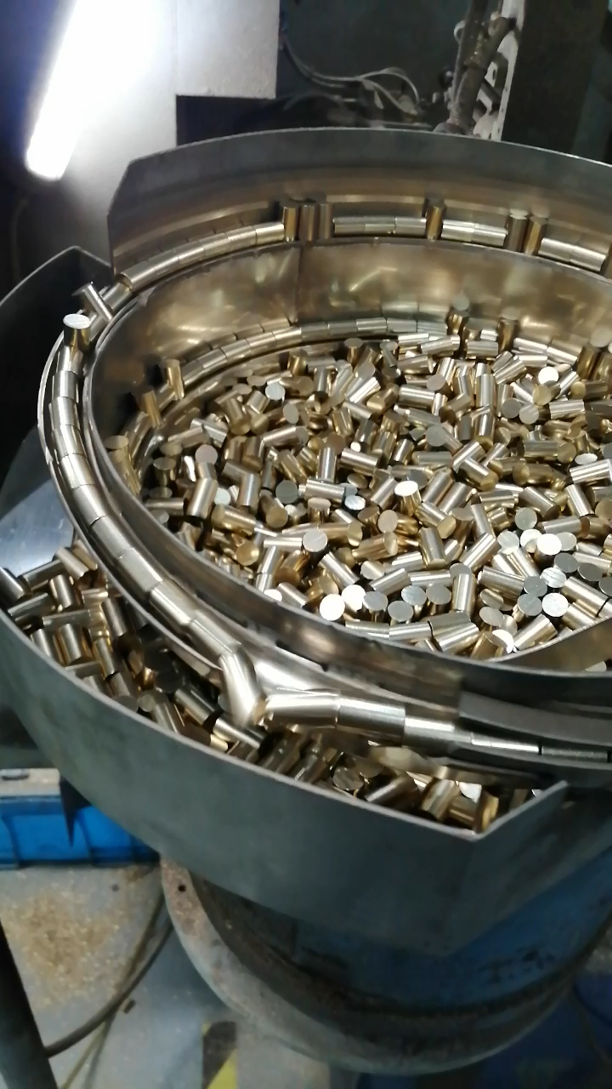
Problem
PROBLEM PIC AND PLACE MANIPULATOR

Slide 4
LIMITATION AND COSIDERATION
Speed of system
Success for system and accuracy
Cost
系统速度
系统的成功
成本

Slide 5
ELEMENTS AND SECTIONS
Gripper
Camera
Controller(cpu)
trajectory
抓手
相机
控制器 (cpu)
轨迹

Slide 6
TASK
Find the object
Plan to get the object
Catch the object
Plan to move
Put in location B
Return back
查找对象
计划获取对象
捕获对象
计划移动
放在 B 位置
返回巴库

Slide 7
Work Draft ( work flow)
After system study
Need to design
Assembly Frame
Ready panel
Griper
Need to design or assemble
Need to design or assemble
Griper Driver
Control section
Need to design and program
Camera
Need to order and assemble
Need to design and program
Command to control
Object detection
Need to design and program
Metal sensor
Need to order and assemble

Slide 8
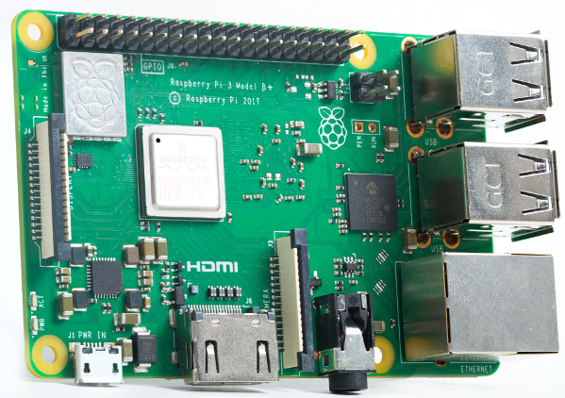
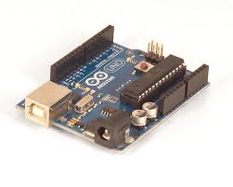
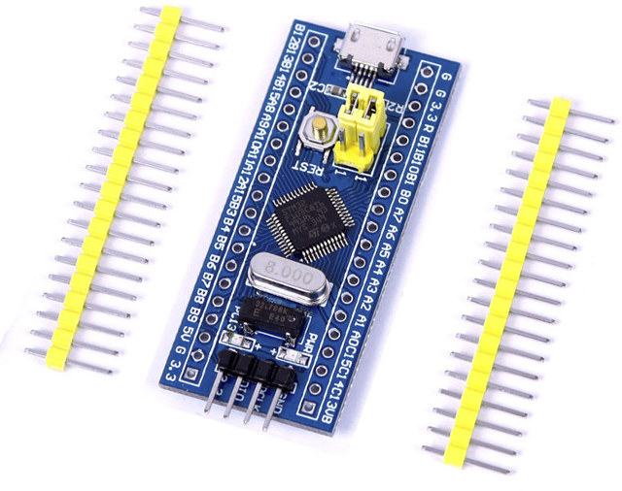
Some section proposition
For Gripper ->
For camera ->pi cam or USB cam
For controller
Main = PI B+
Auxiliary and Planner =Arduino or STM32
对于抓手->所提供的模型 ->Fest
对于相机-> pi 凸轮或 USB 凸轮
适用于控制器 主要->pib
计划->arduino

Slide 9
Pervious research work and background

Slide 10
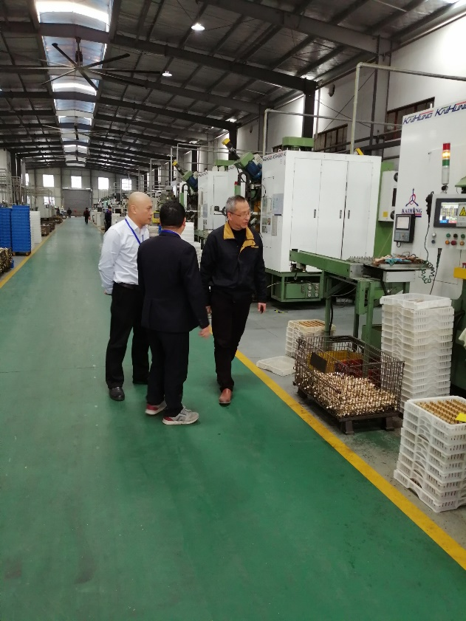
Some other Project Picture

Slide 11
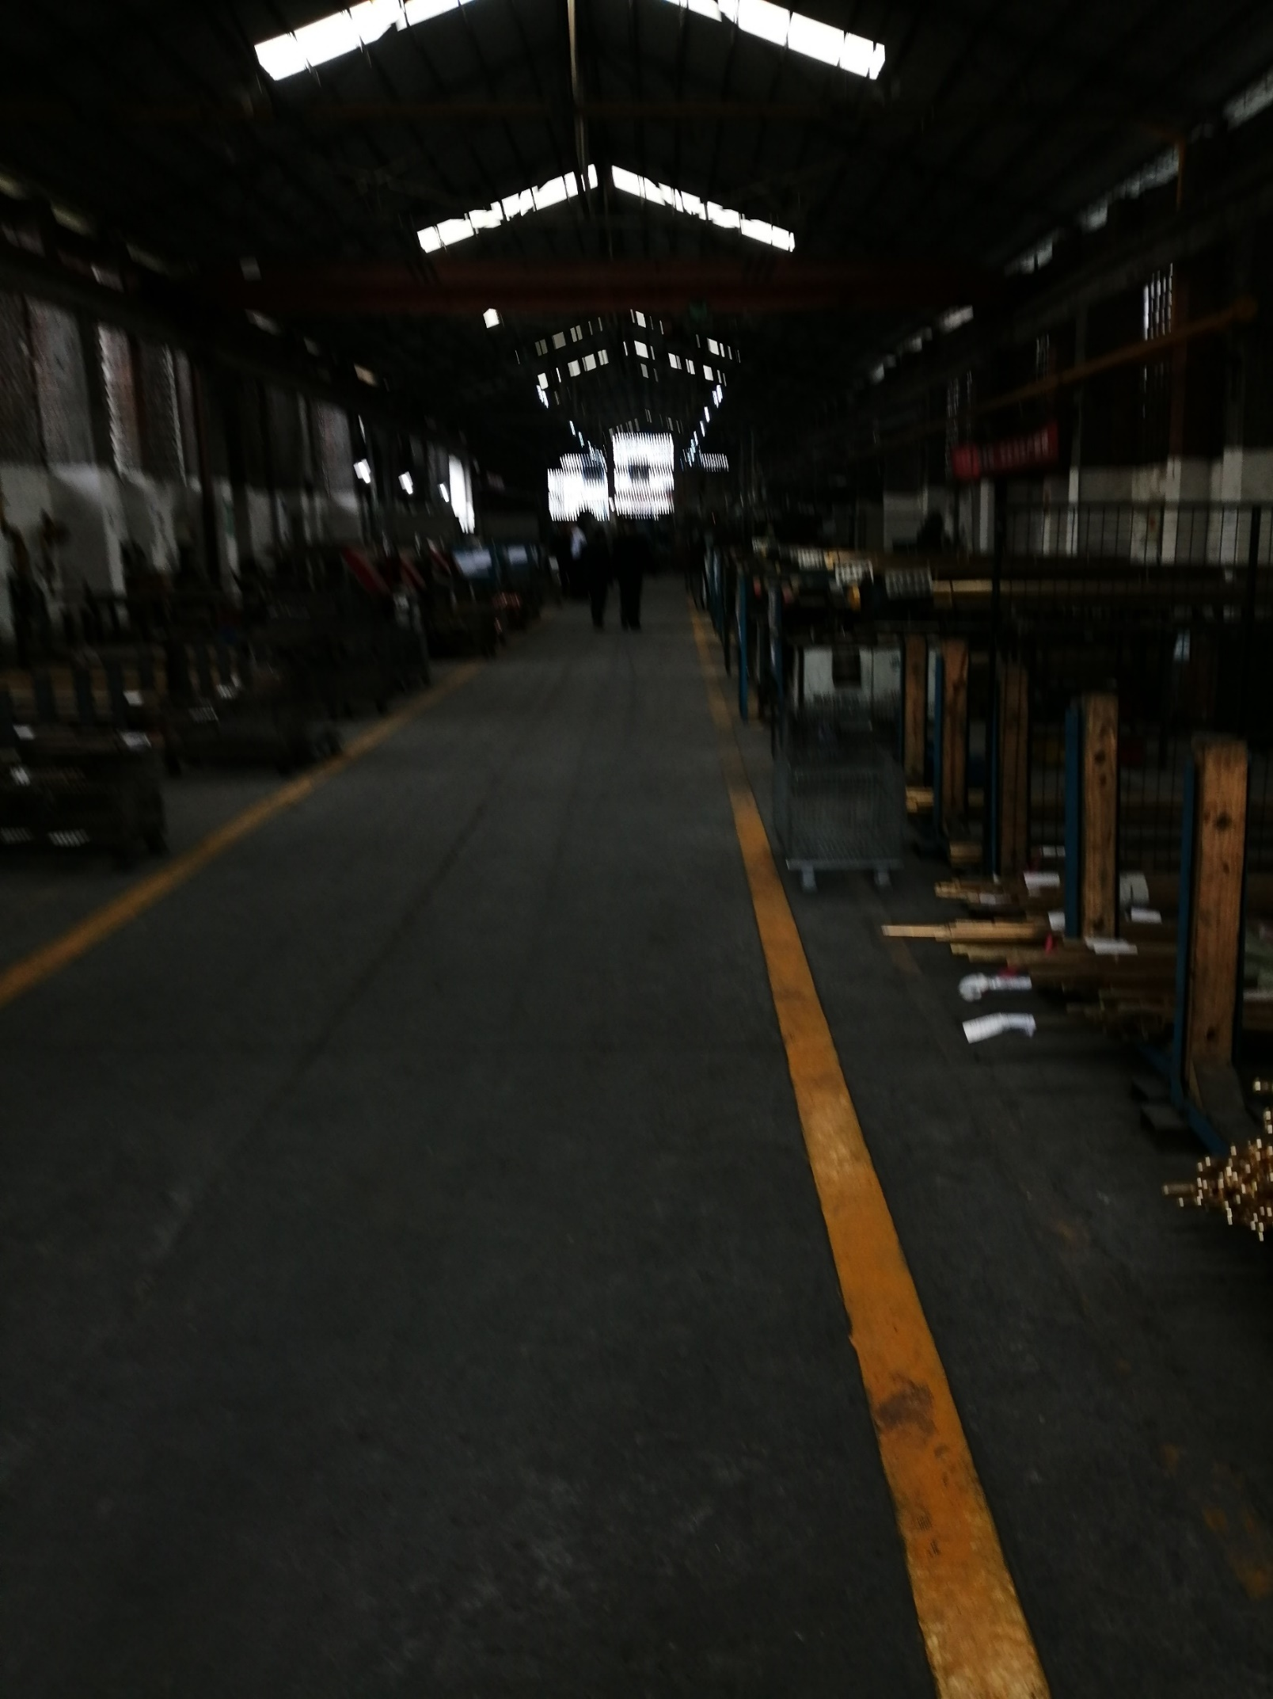

Some other Project Picture

Slide 12
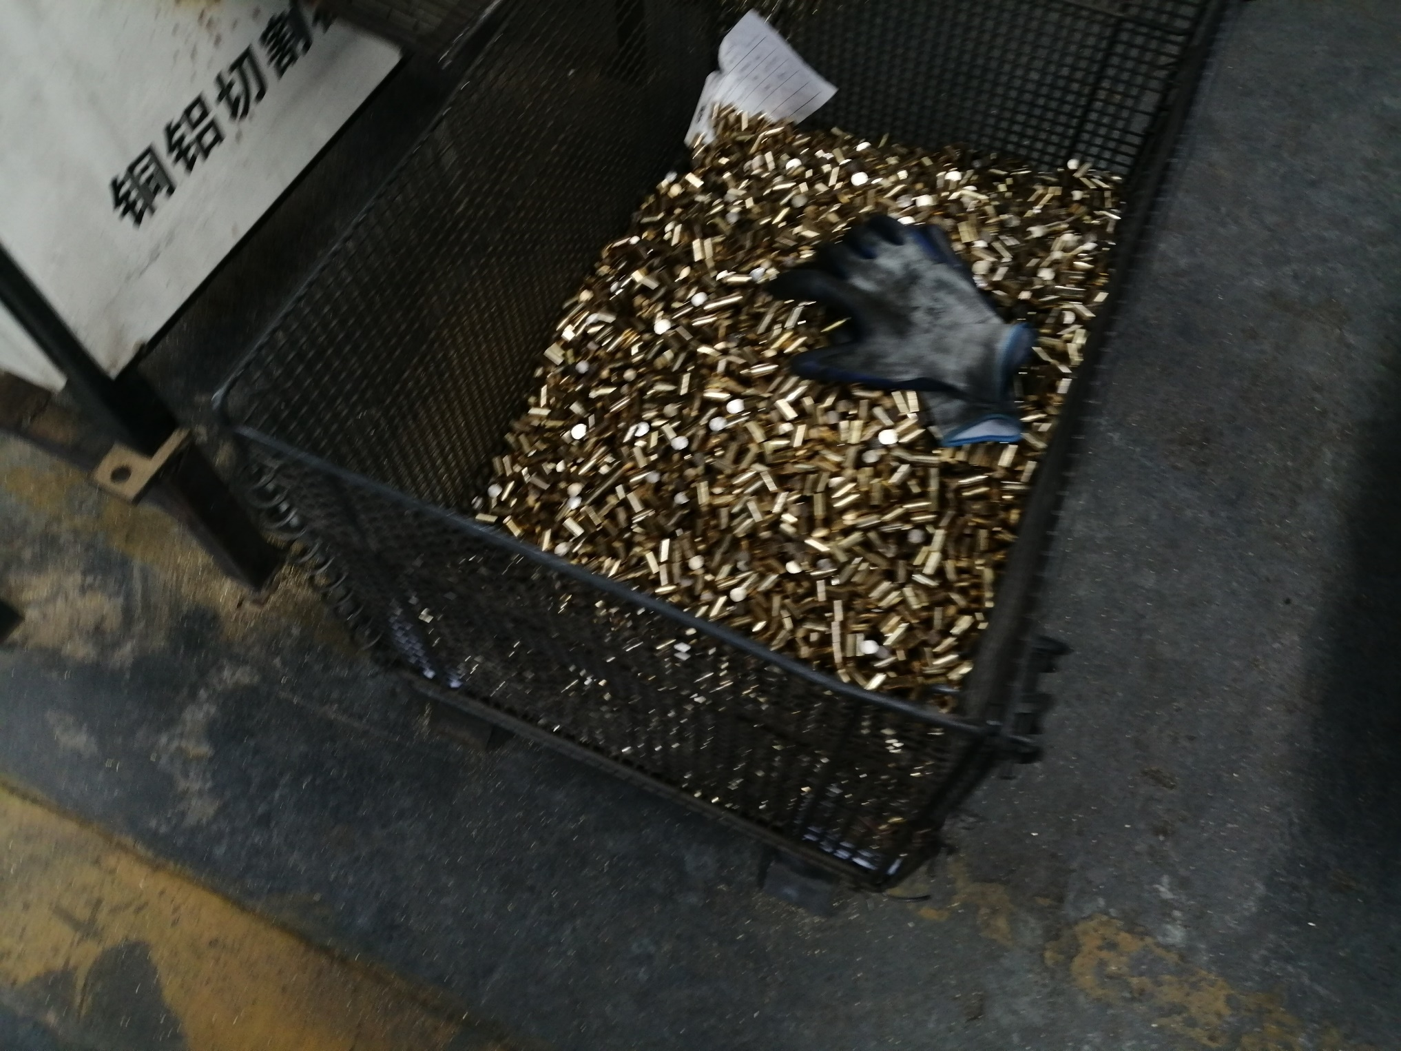
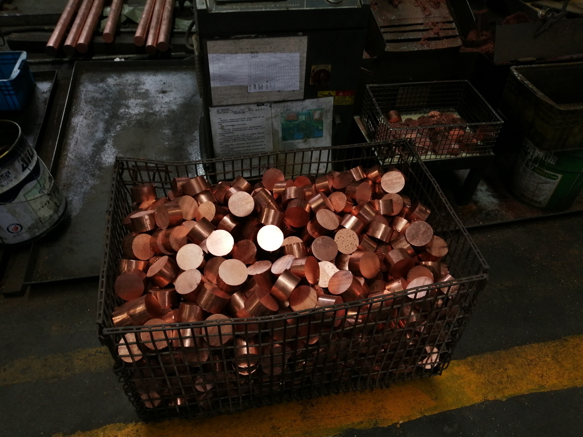
Some other Project Picture

Slide 13
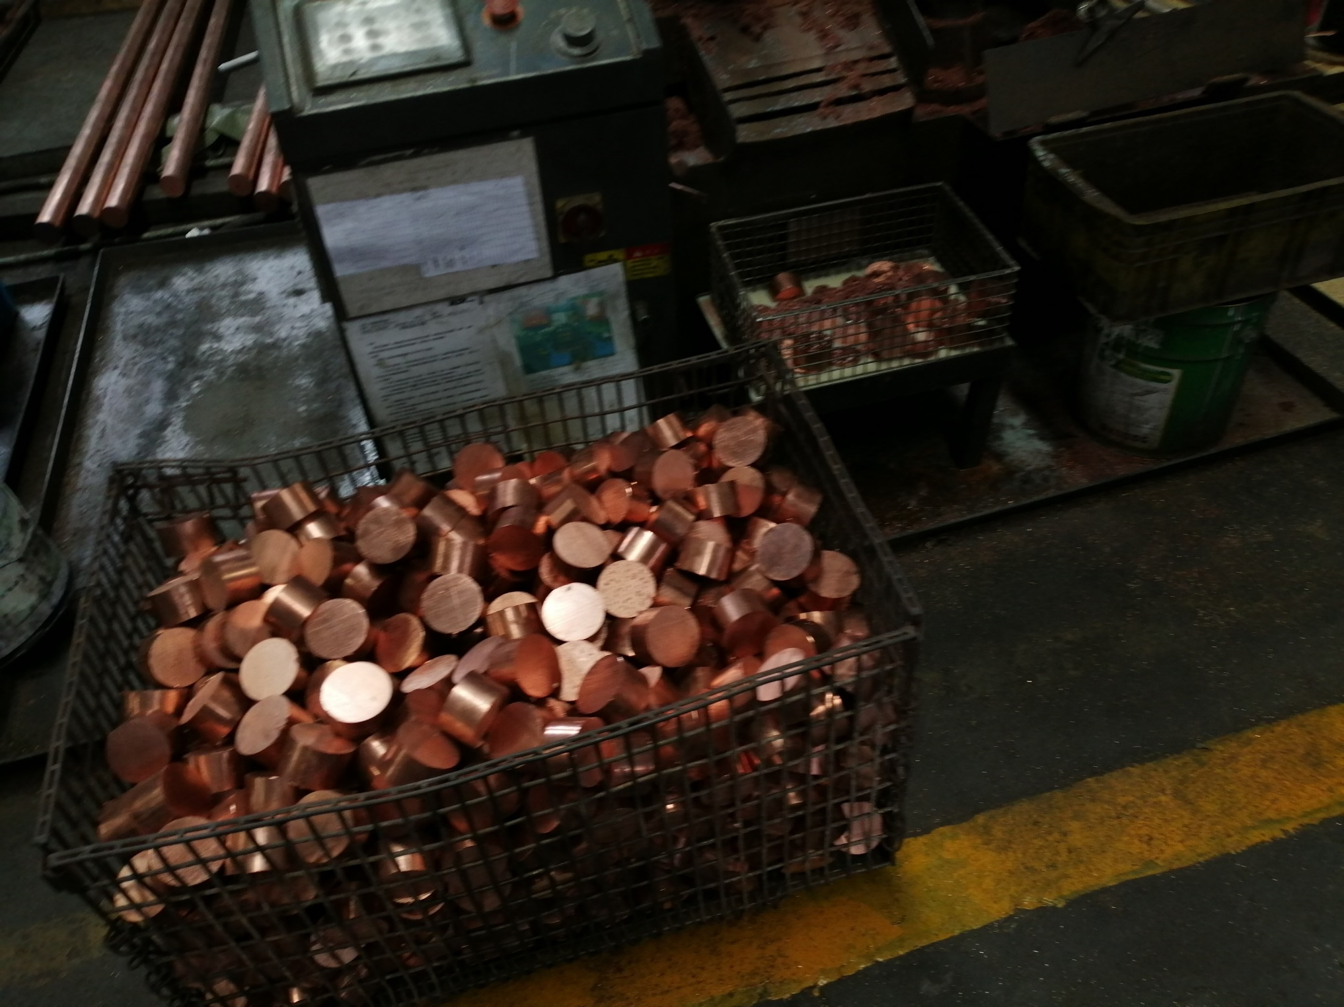
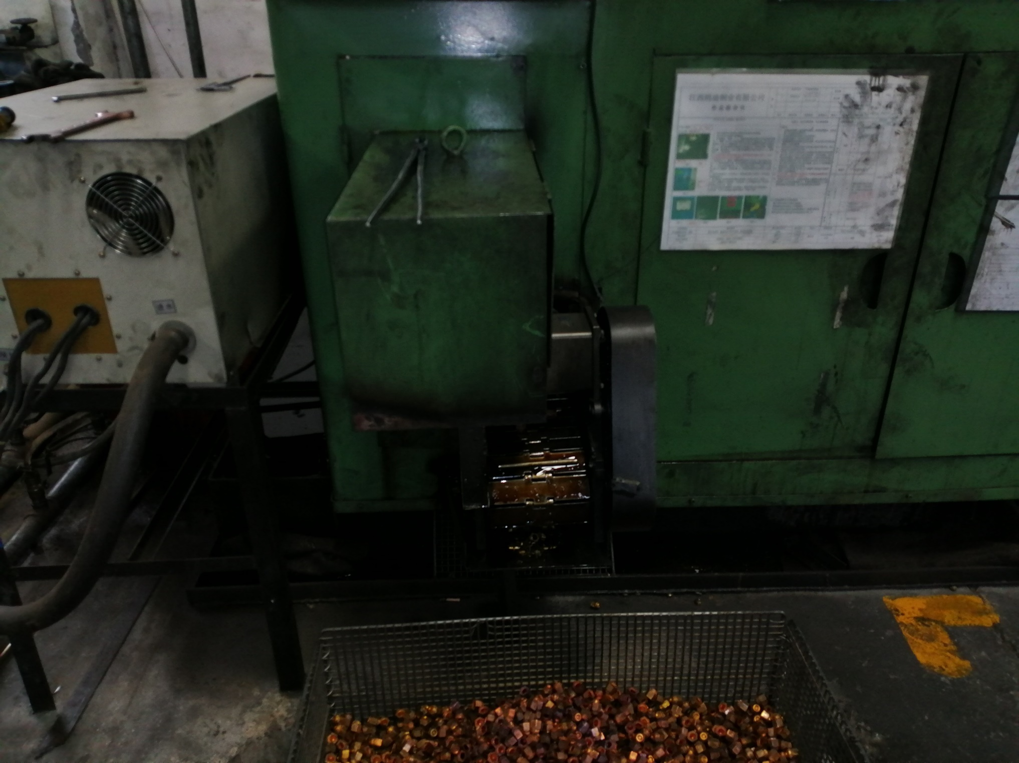
Some other Project Picture

Slide 14
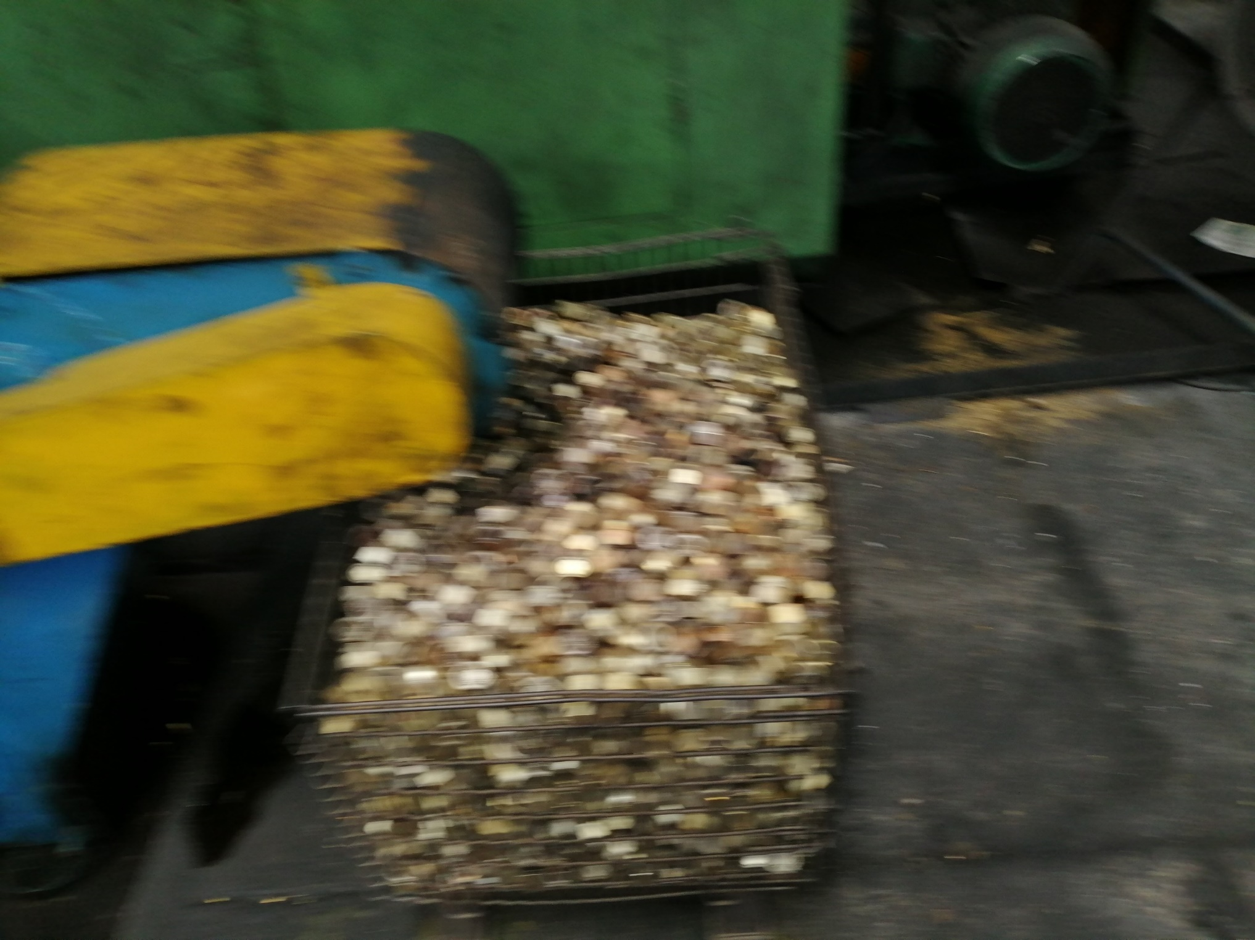
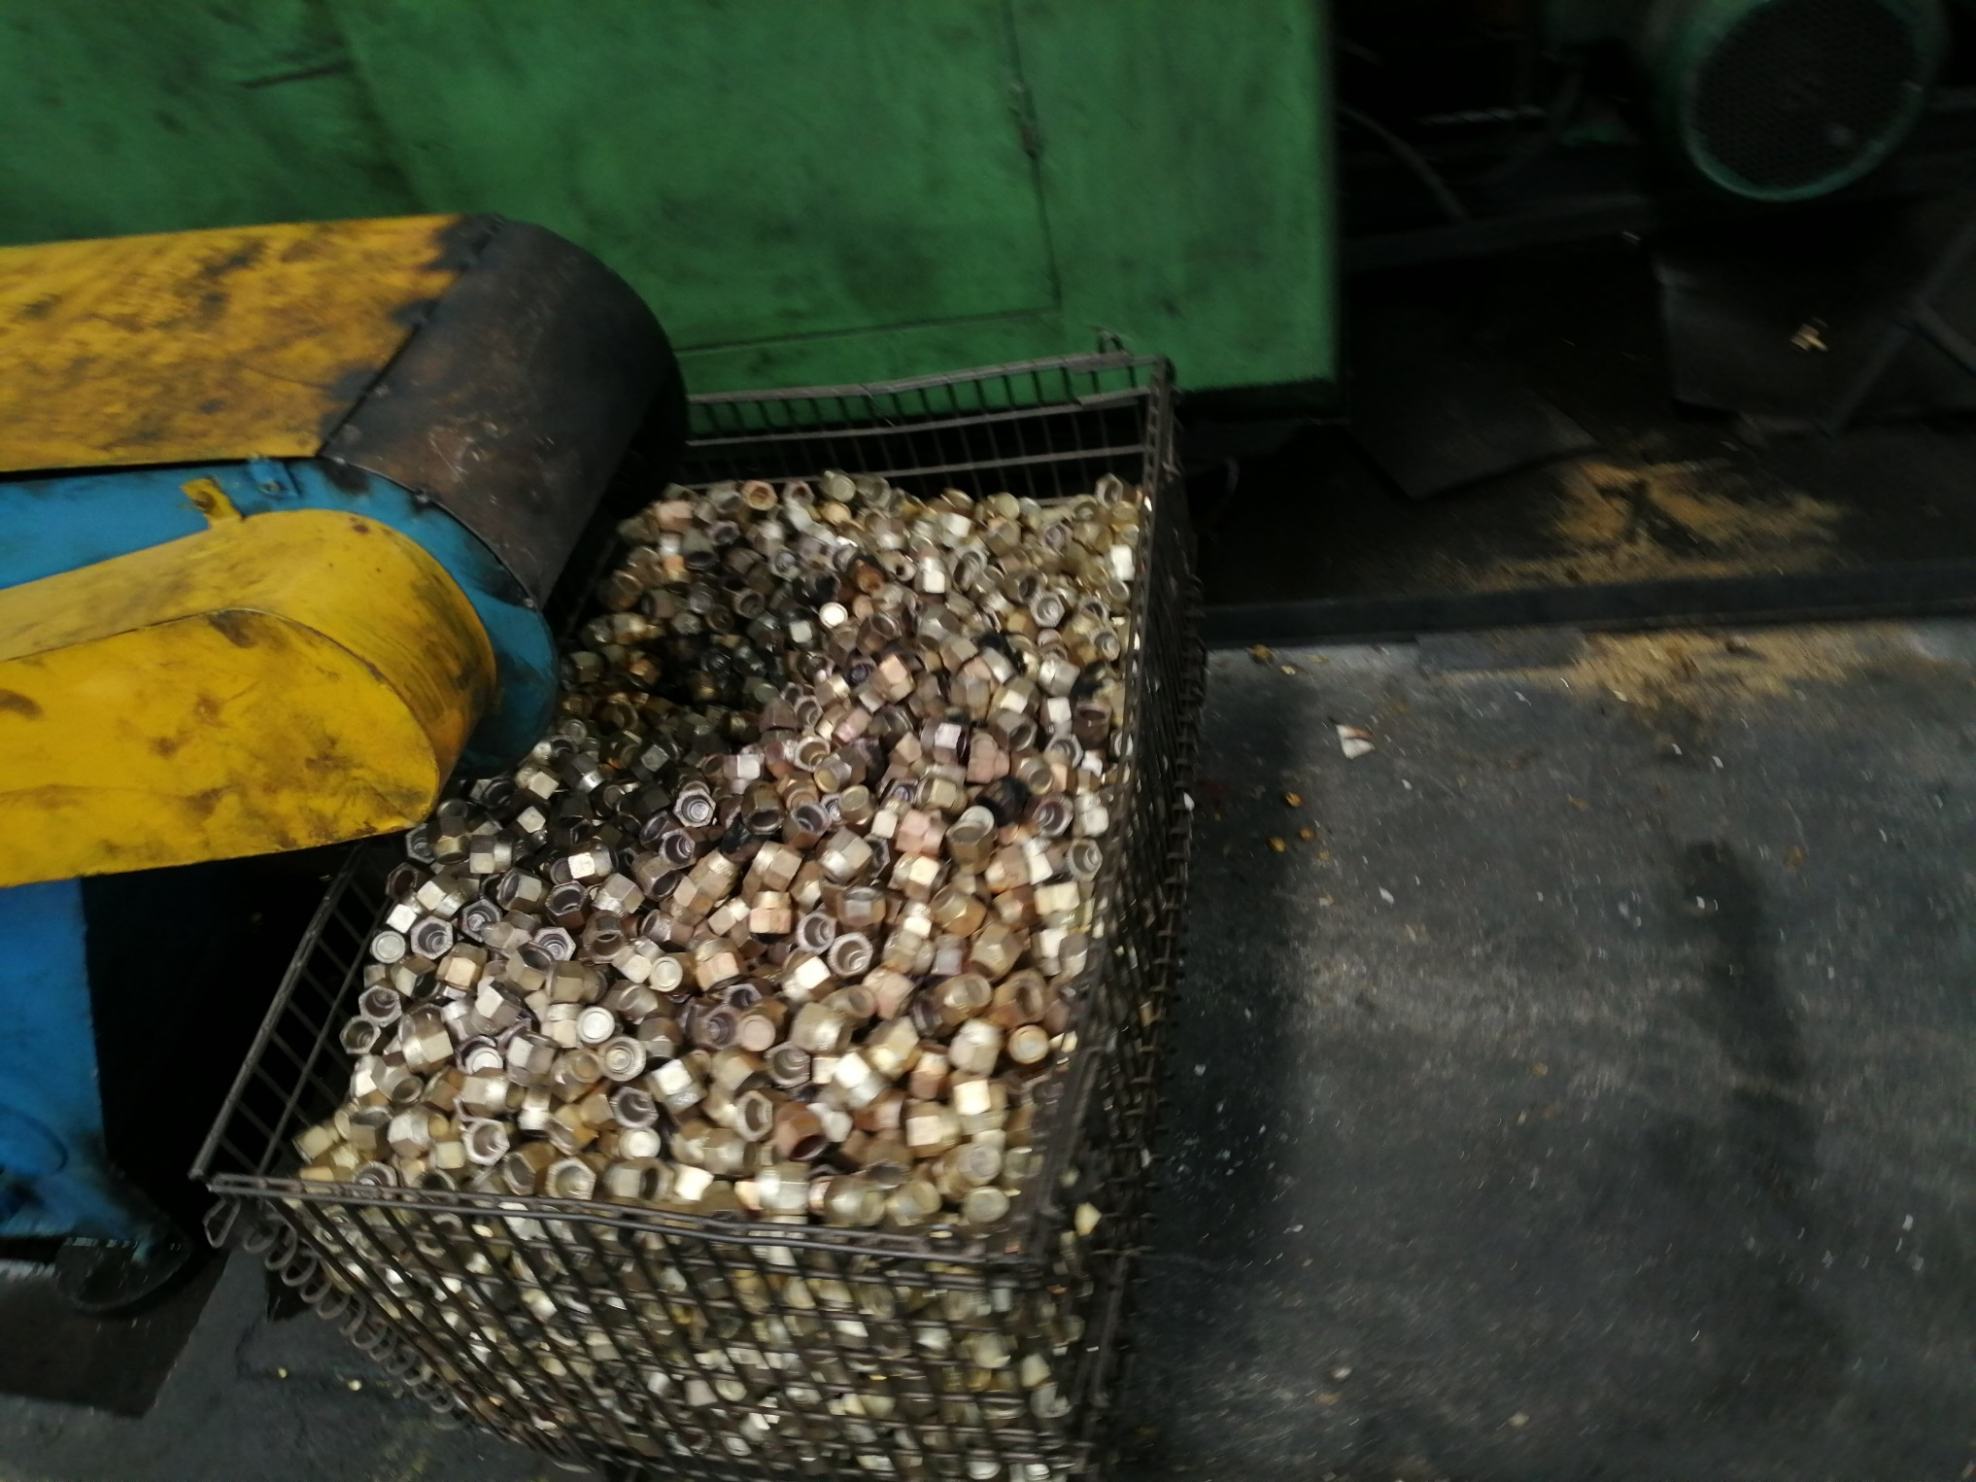
Some other Project Picture

Slide 15
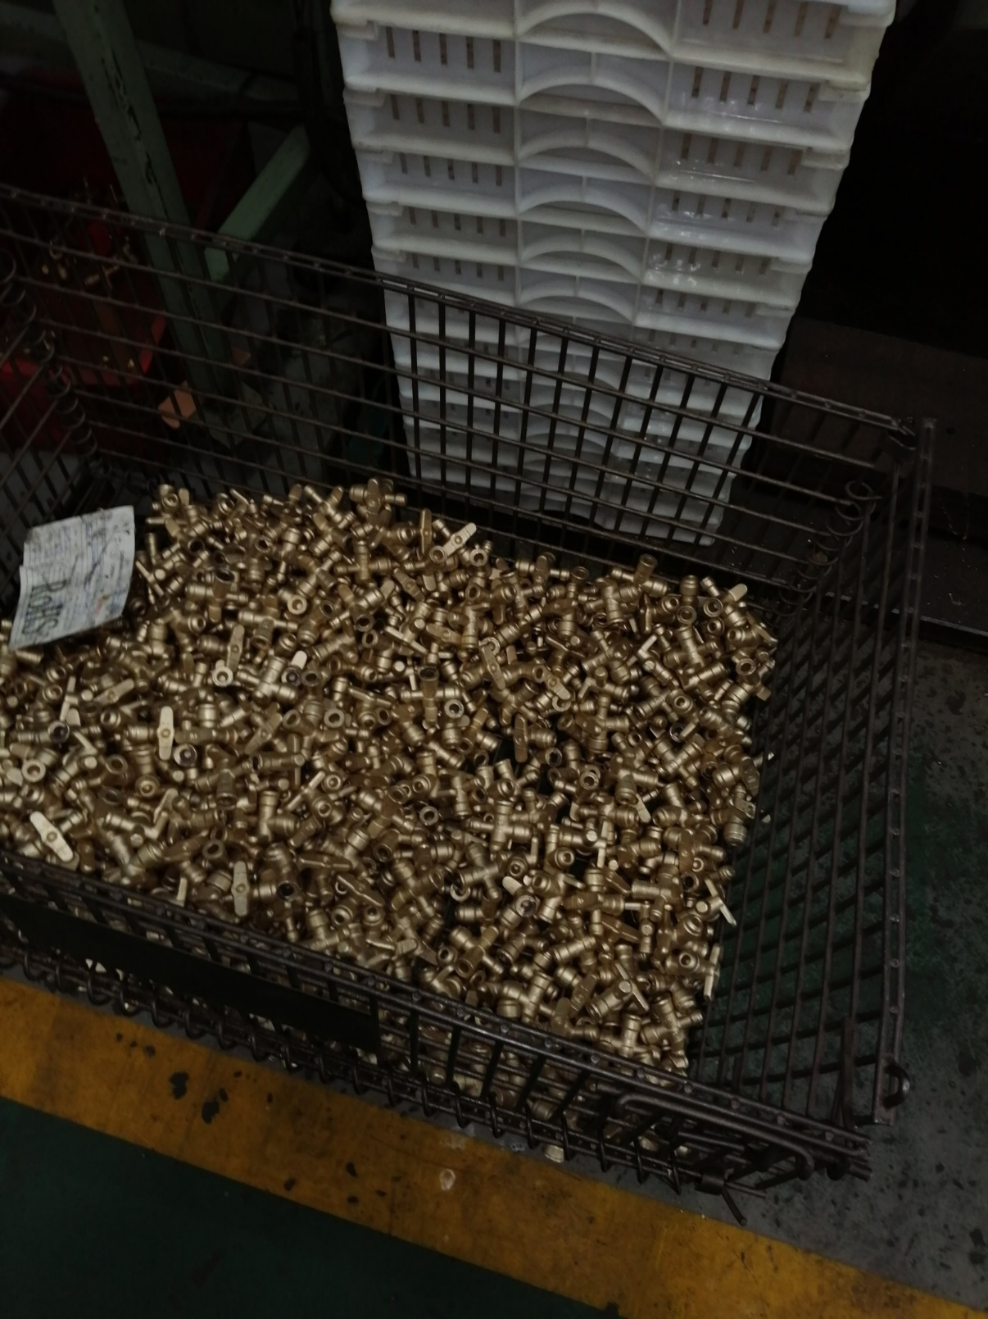
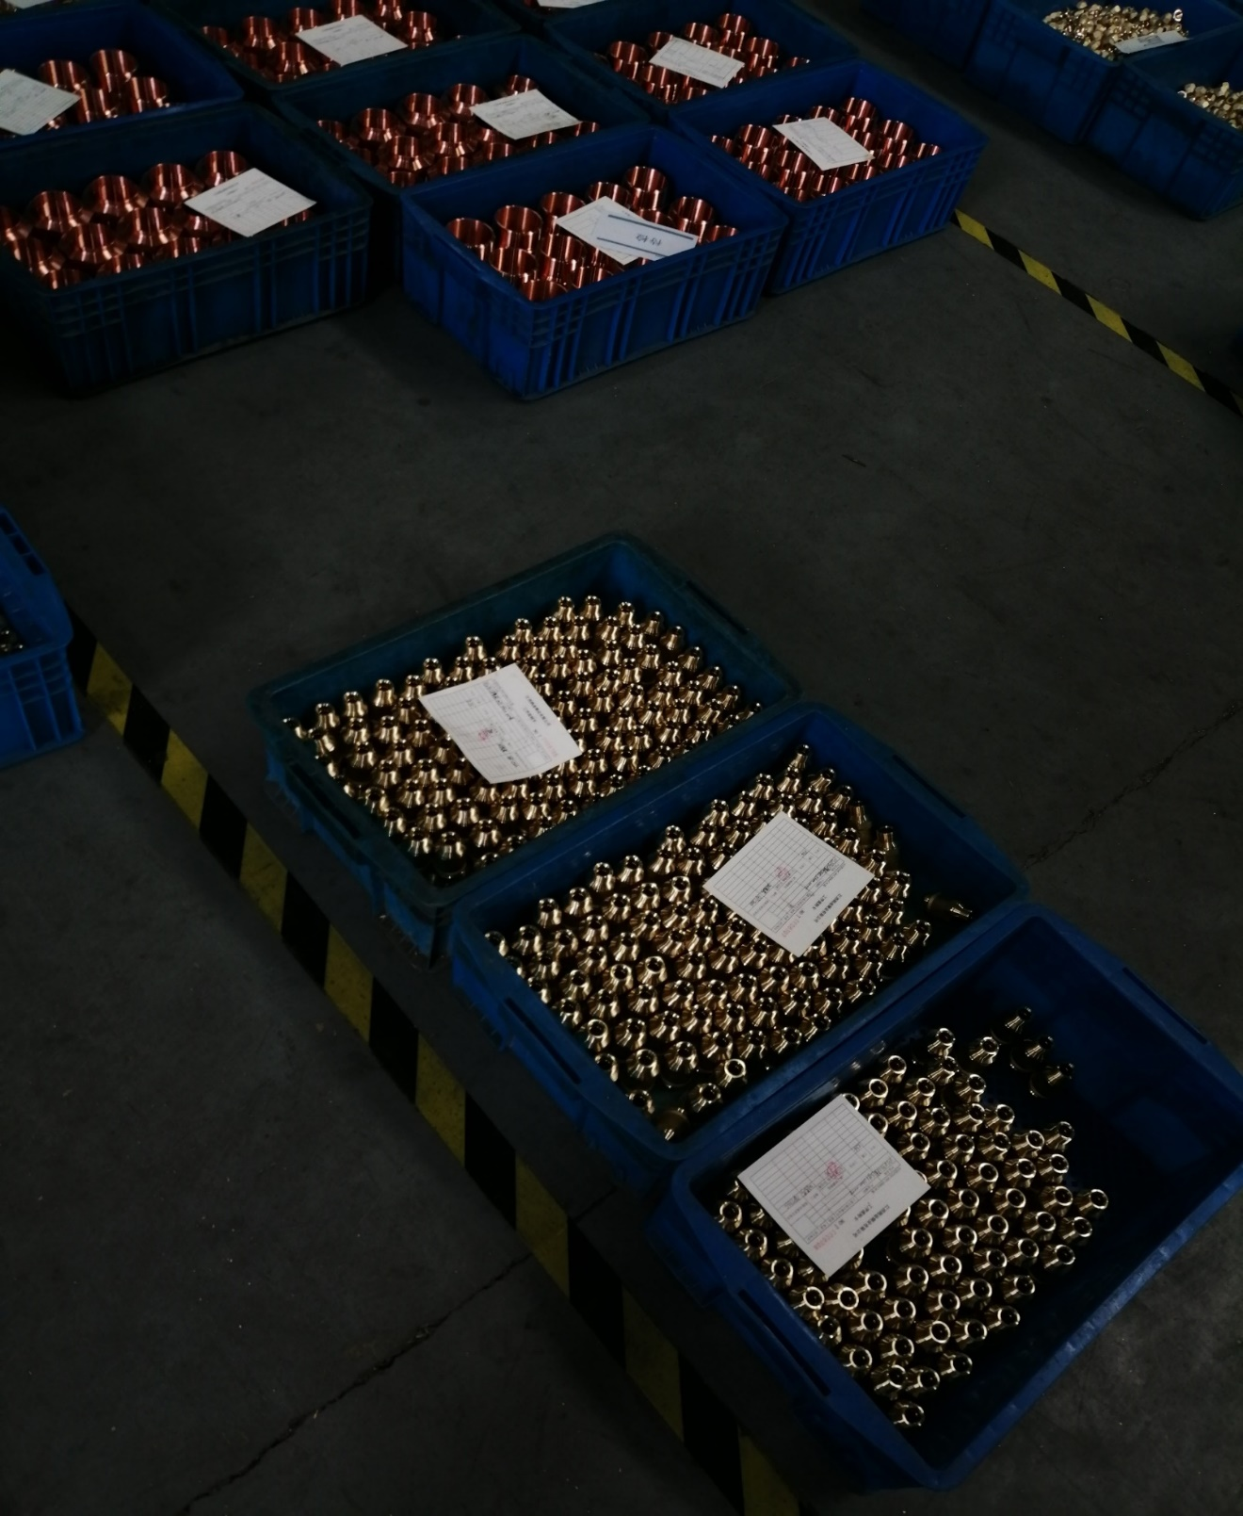
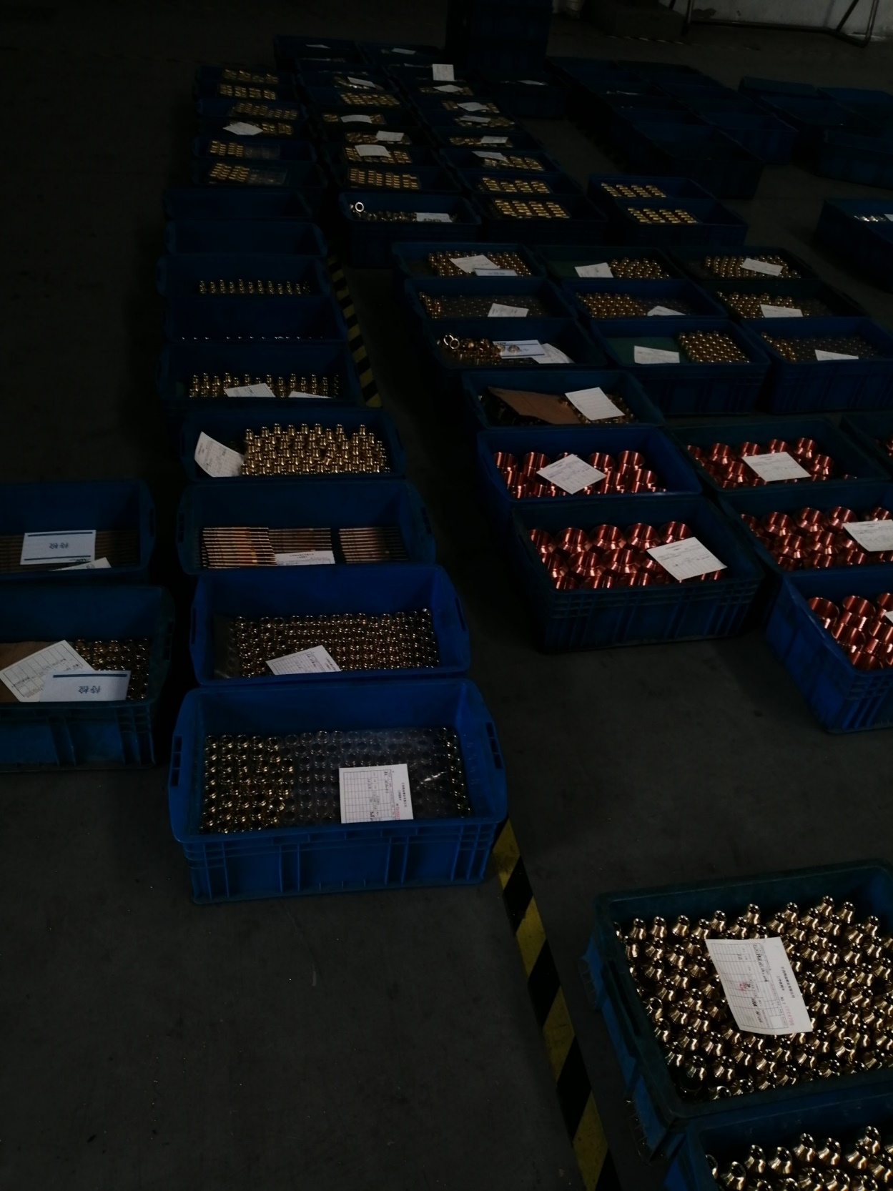
Some other Project Picture

Slide 16
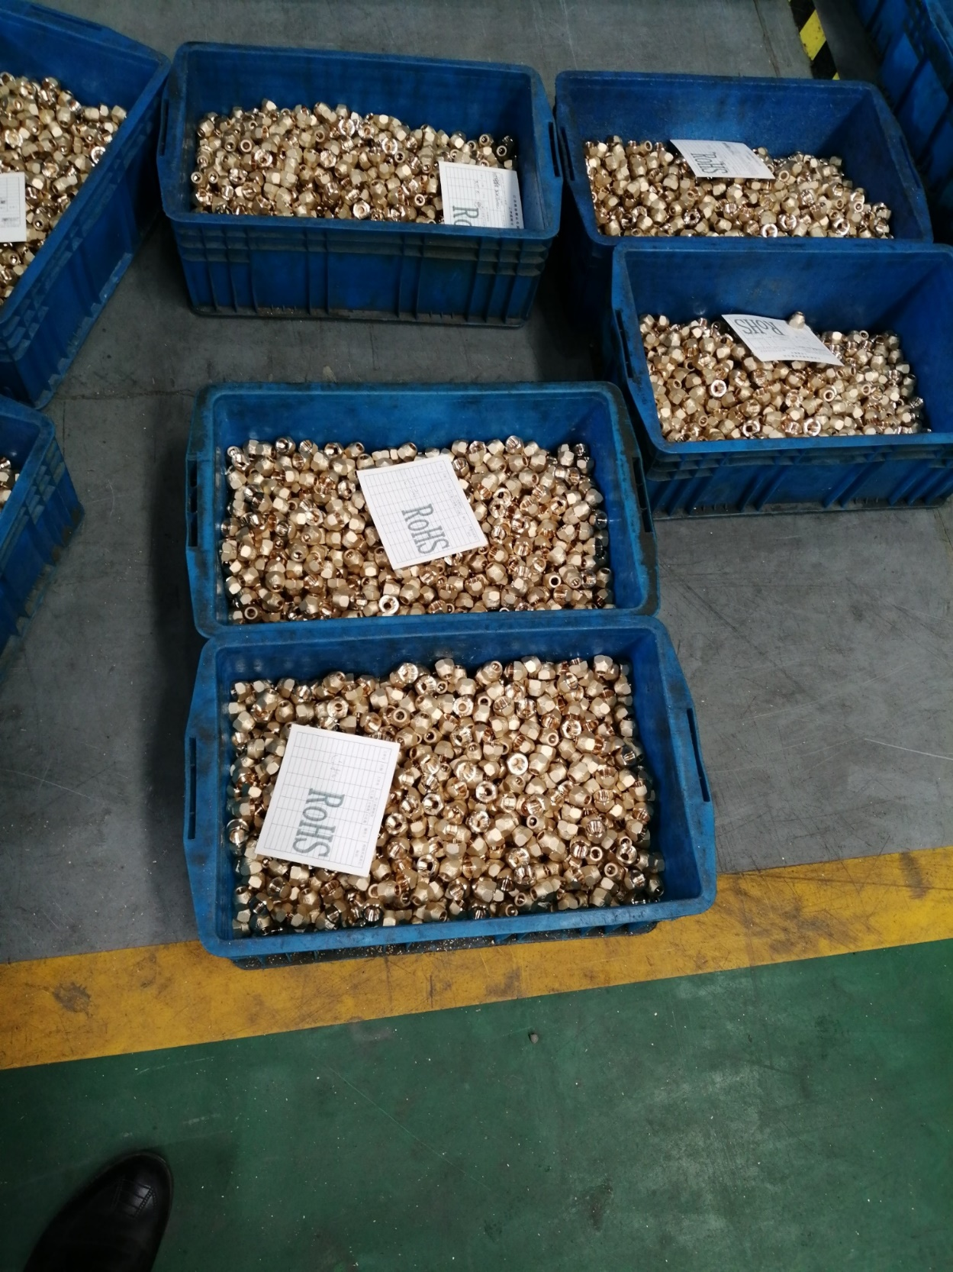
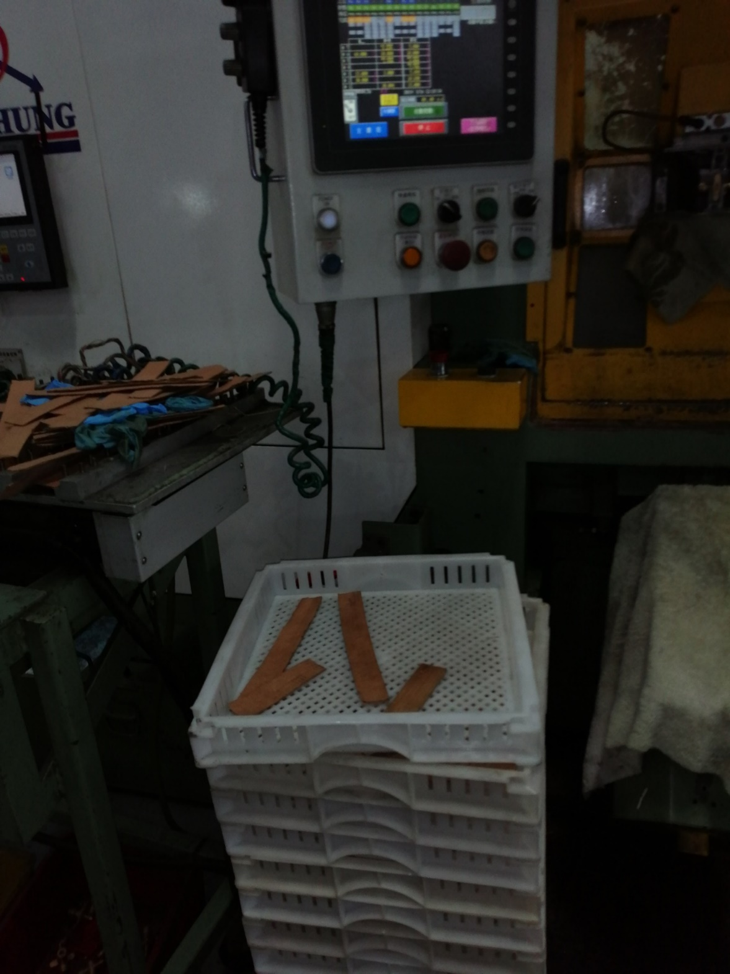
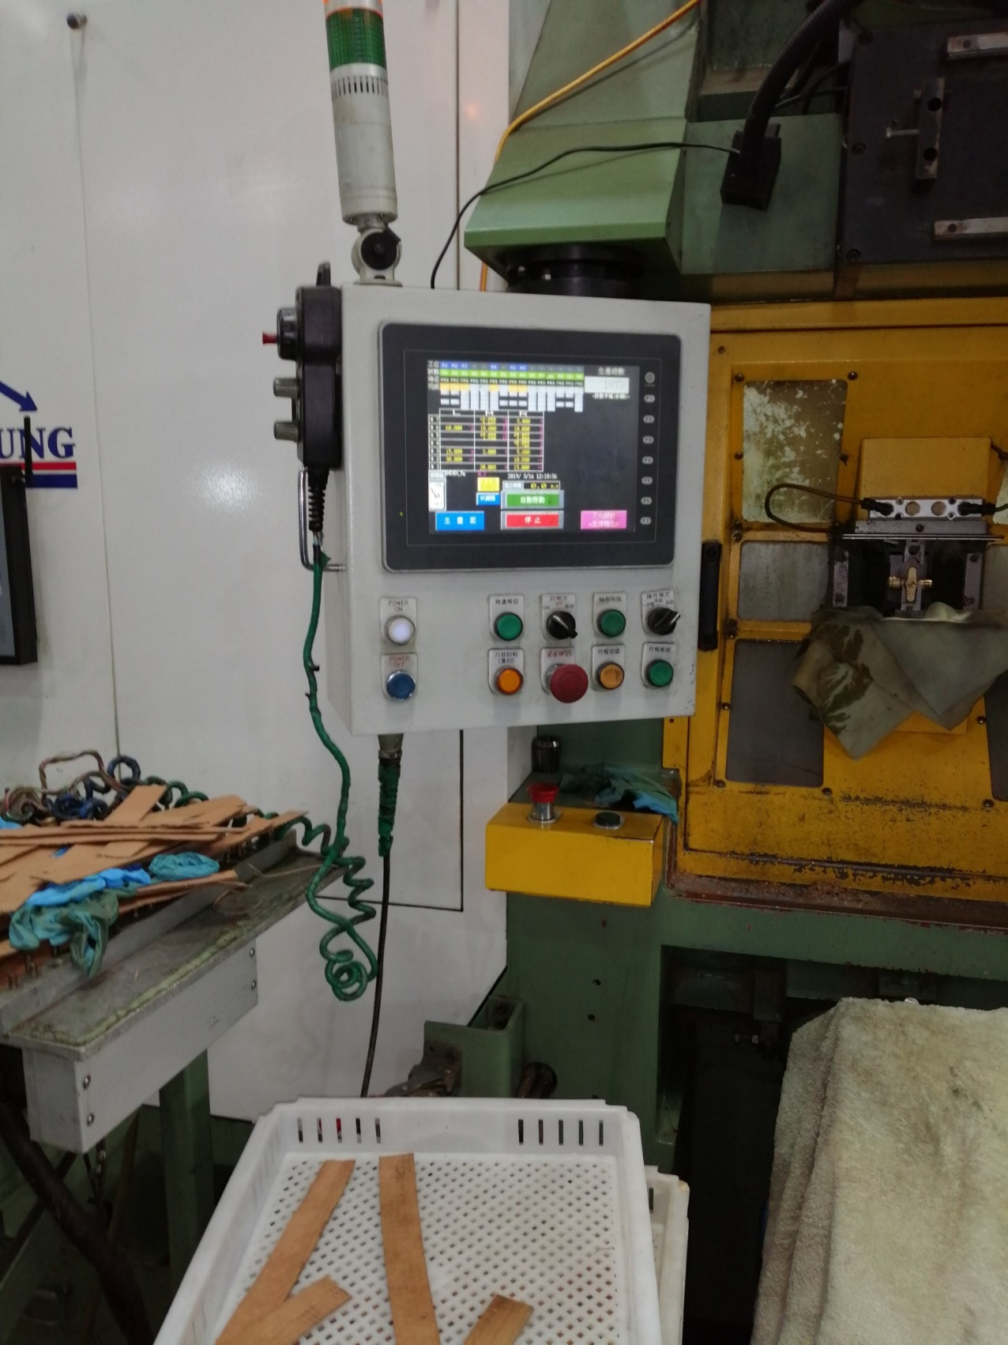
Some other Project Picture

Slide 17
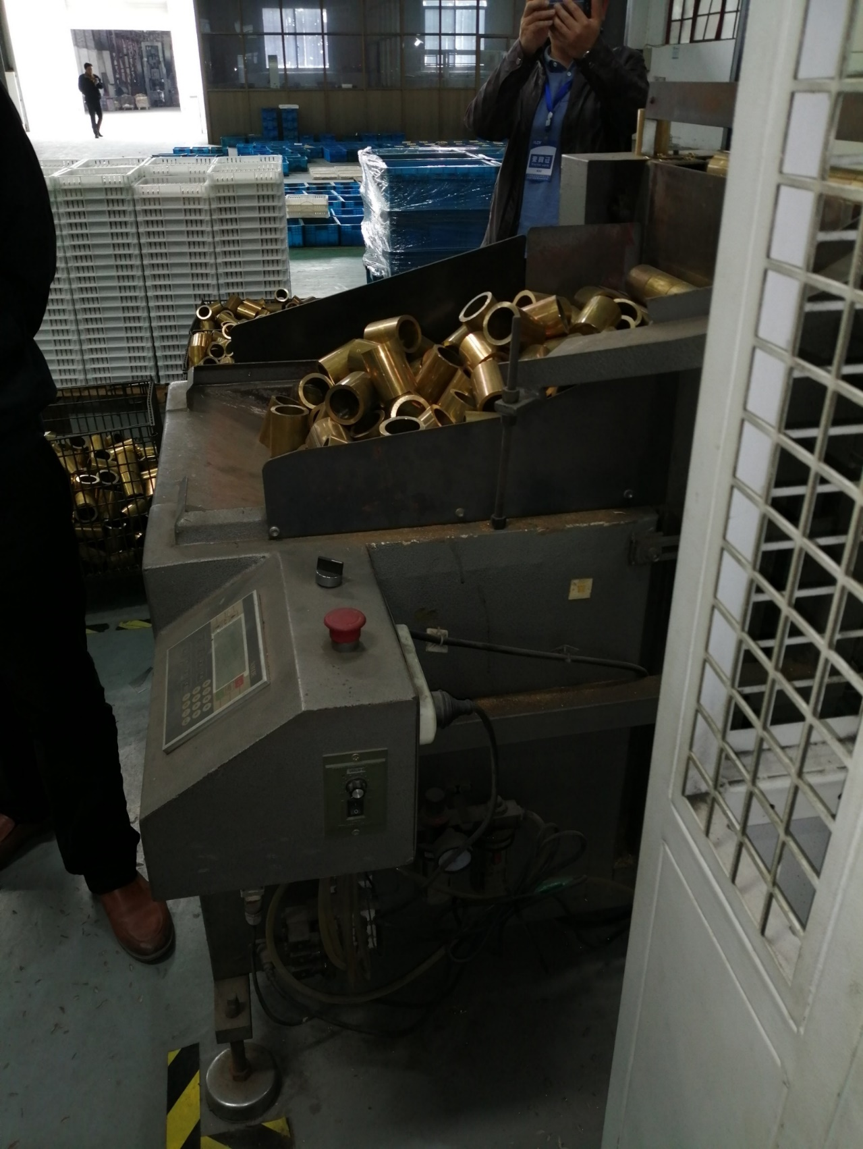
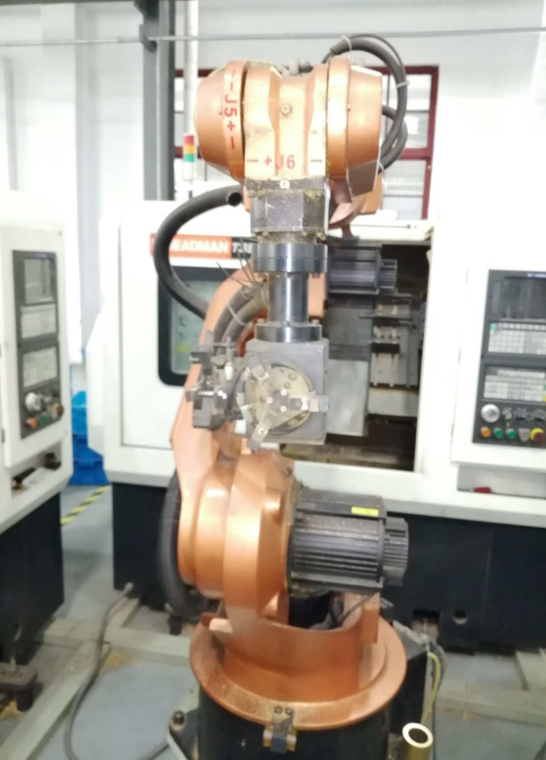
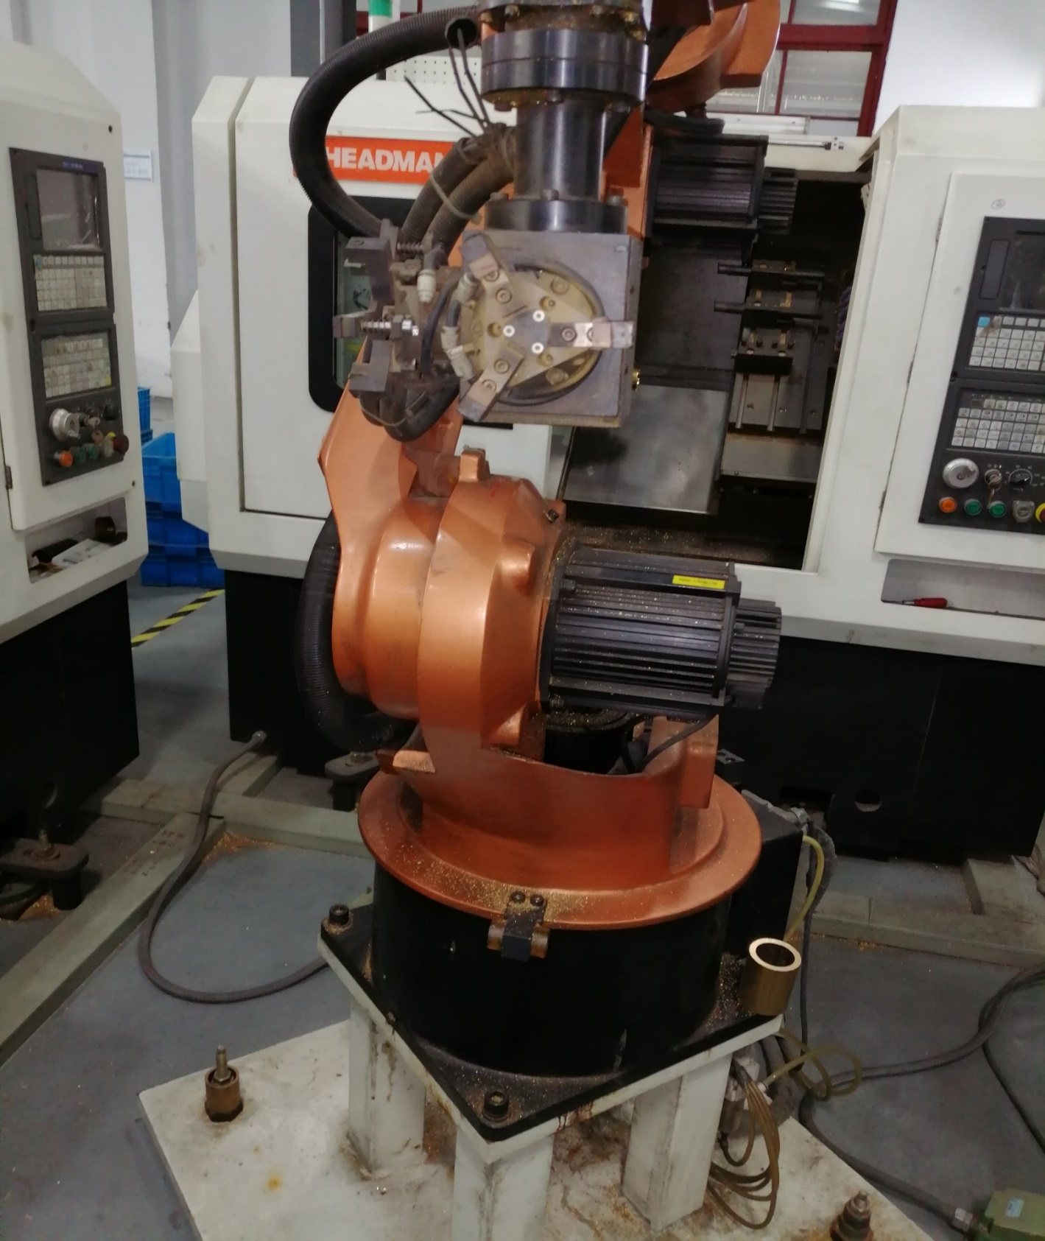
Some other Project Picture

Slide 18
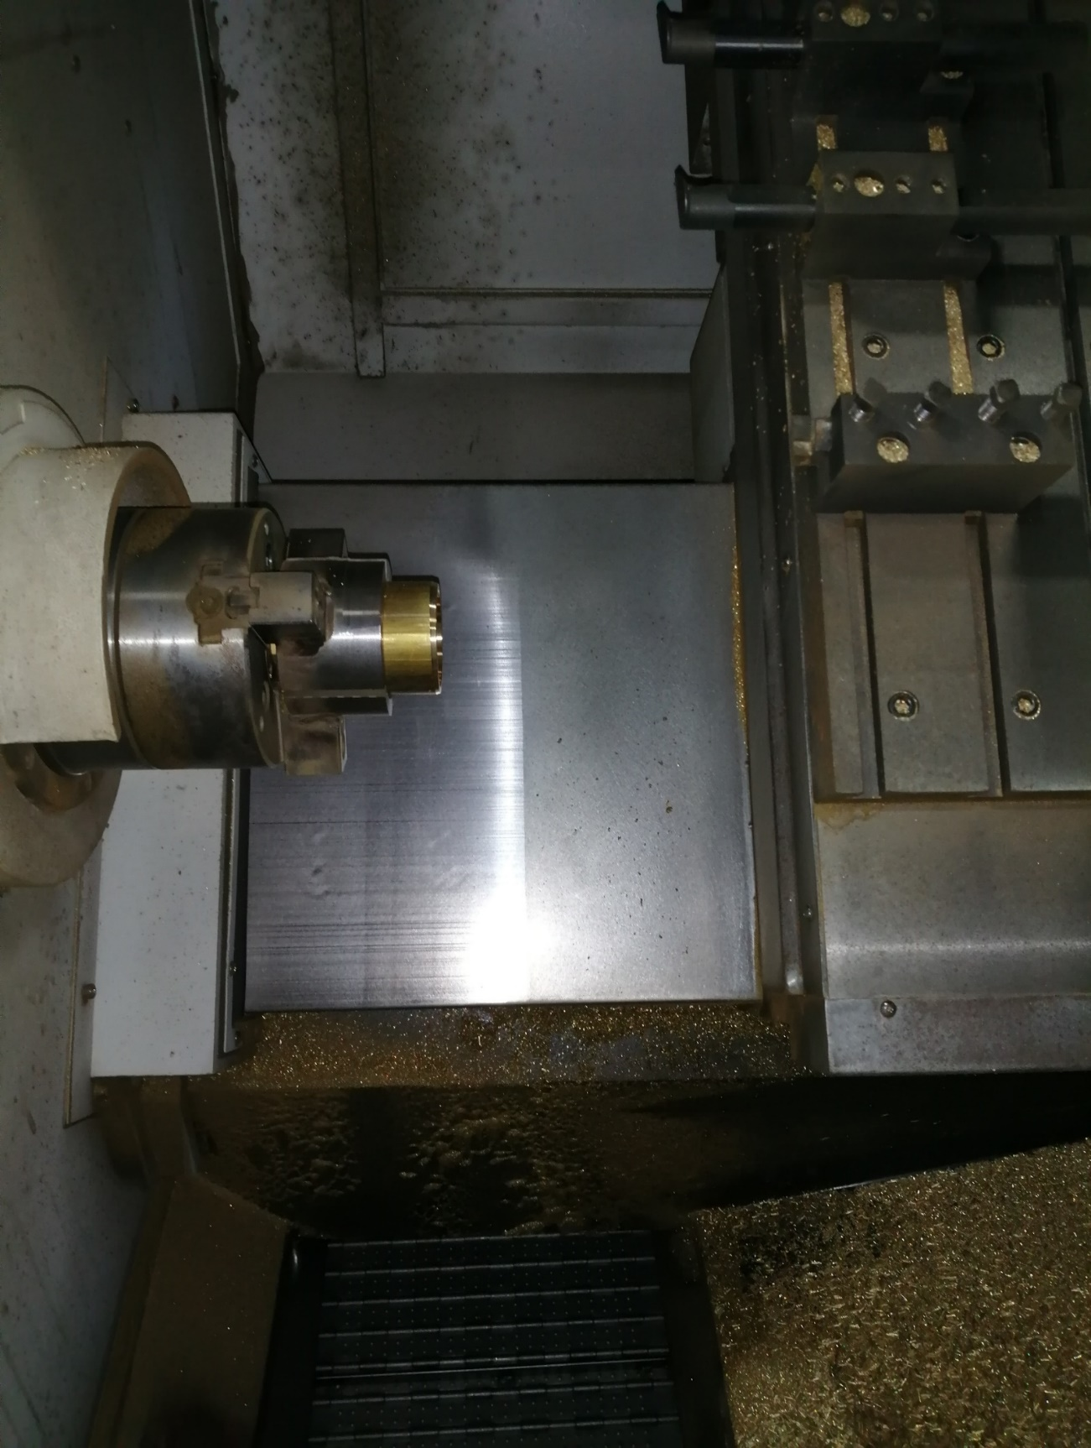
Some other Project Picture

Slide 19
Team Member And Key Person

Slide 20
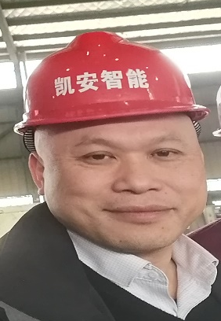
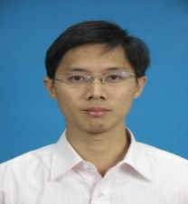
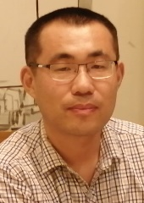
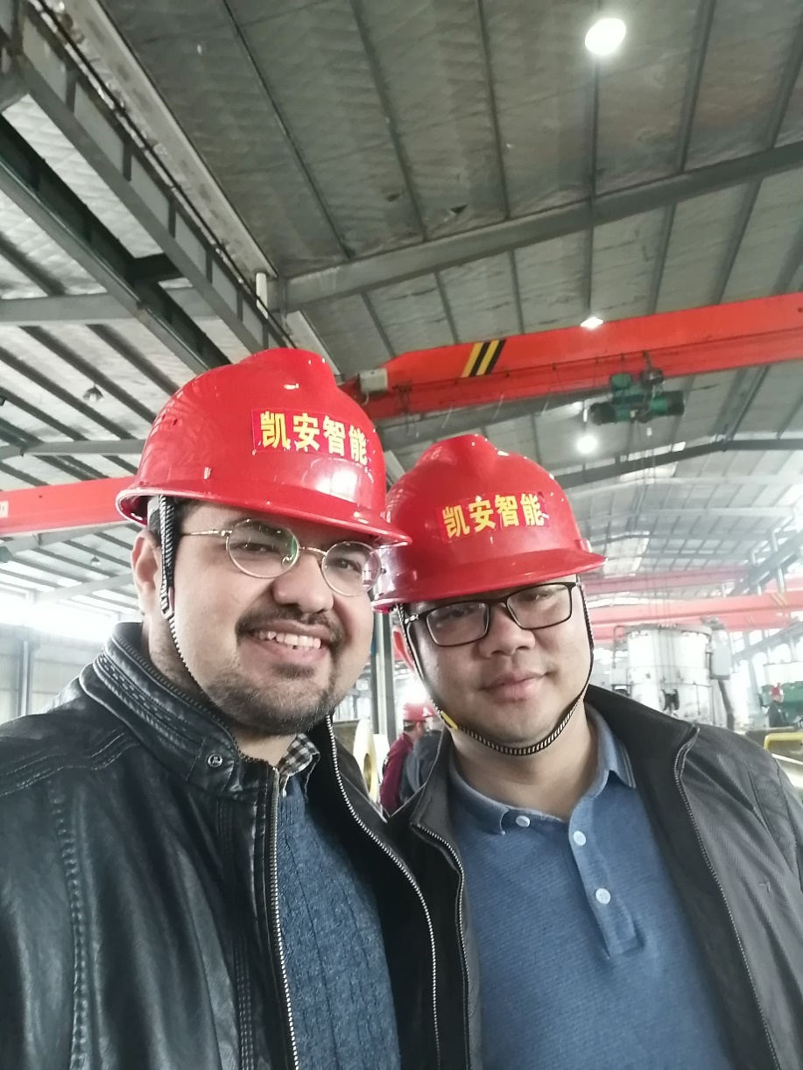

MEMBERS
Prof 廖列法
Prof 黄学雨
Prof: Liefa Liao
Position: Dean.
Position: Dean.
Dr. Shuai Li
Dr. 李帅
Prof 谢辉
Position: associate professor.
Position: associate professor.
Dr. 阿塔-贾汉吉尔-莫沙耶迪
Dr Ata Jahangir Moshayedi
Position: associate professor.

Slide 21
Name | Position | Experience | Section
Prof: Liefa Liao

